Slide 1
Some Recent Results on AI Security
Written by：Minze Xu, Boyu Zhu, Wei Tong, Yunlong Mao, Yuan Zhang, Jingyu Hua
Speaker: Sheng Zhong (Nanjing University)

Slide 2
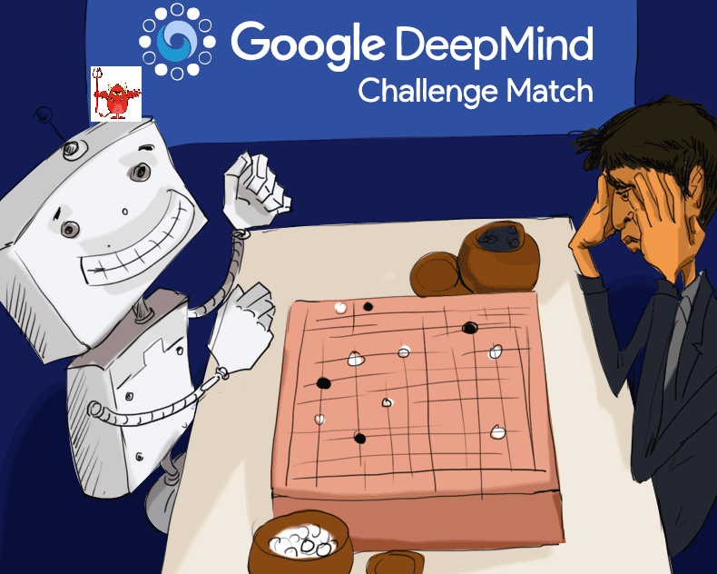
AI & Security
AI surprised the world, so did its security issues.
  In March 2016, AlphaGo Beated Lee Sedol 4-1.
  In March 2017, it beated Ke Jie 3-0. Human beings no longer have got any chance against Go AI since then.
  AI is so powerful; its security issues are so painful.

Slide 3


Some Security Problems
Passive Attacks on Machine Learning—Data Privacy
Learning Machines could be bad—the Backdoor Problem
Active Attacks on Machine Learning—Adversarial Examples
Machine Learning

Slide 4
Outline
Privacy Issues in Machine Learning as a Service (MLaaS)
Adversarial Attacks
Adversarial Defense
Backdoor Attacks on Neural Networks

Slide 5
Outline
Privacy Issues in Machine Learning as a Service (MLaaS)
Adversarial Attacks
Adversarial Defense
Backdoor Attacks on Neural Networks

Slide 6
Machine Learning as a Service (MLaaS)
Deep Neural Network(DNN)
MLaaS
  The deep neural network model works better than traditional machine learning methods, benefiting from more parameters, more training data and more computation.
  Pros: Algorithms are simple and easy to implement without feature engineering.
  Cons: More training data and more computing resources are needed.
  Scenario 1: The user provides data and model, while the service provides model optimization.
  Scenario 2: The user provides the data, while the service provides the resources and algorithms for training.
  Scenario 3: The user make queries only, while the service does everything else.
  Popular MLaaS Platforms:
    Amazon AWS、IBM Watson、Baidu PaddlePaddle

Slide 7
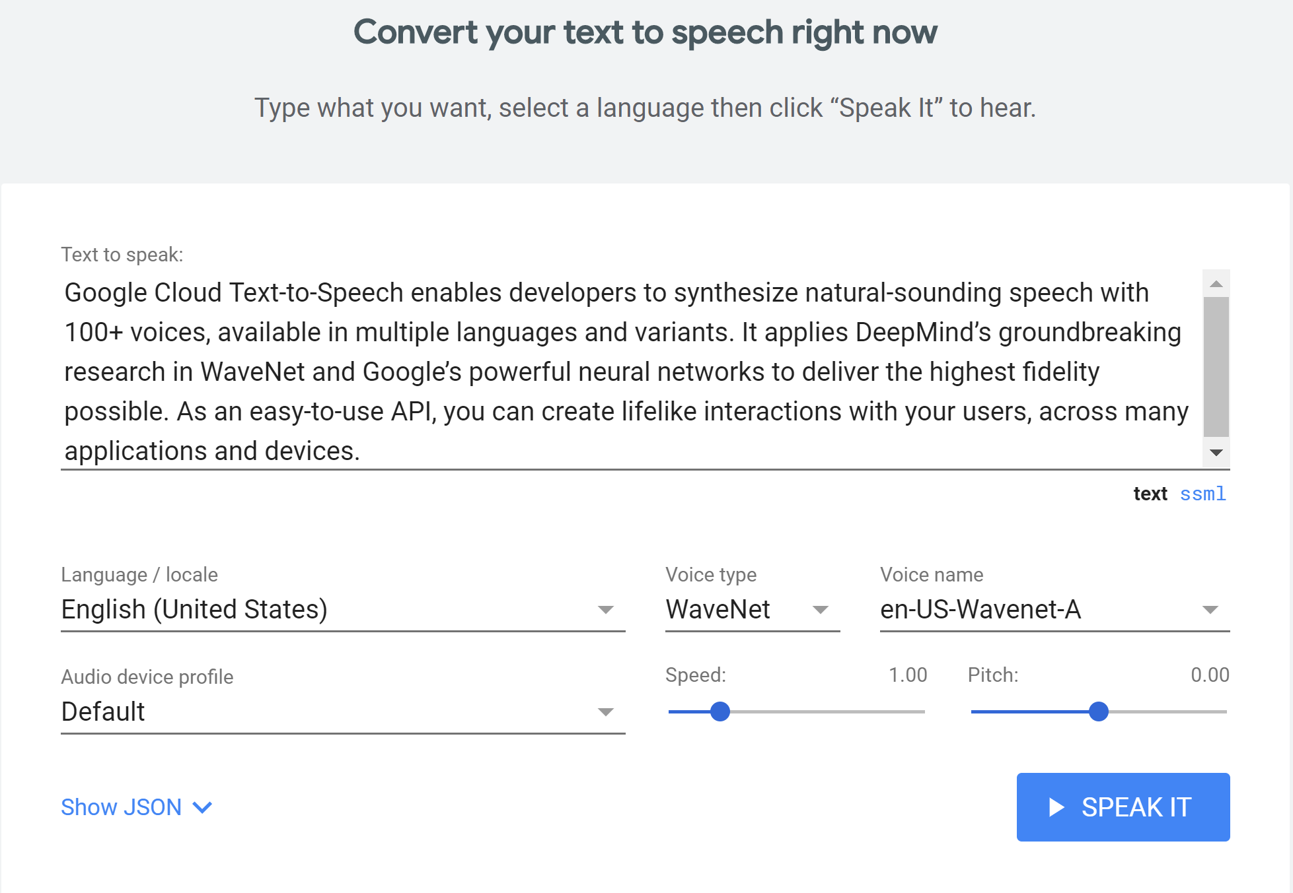
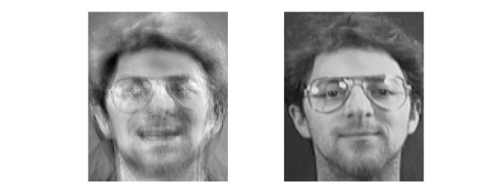
Privacy Leakage Problems in MLaaS
Training data leaked to the querying user
Model parameters leaked to the querying user
And…
User queries
leaked to the service provider
The service provider uses private data sets to train the model.
The user attempts to steal training data through making queries.
The model trained by the service provider is private intellectual property.
The user attempts to steal the model parameters or the hyperparameters through making queries.
User queries are submitted in plaintext.
But these queries could be sensitive.
Stolen data
Raw data

Slide 8
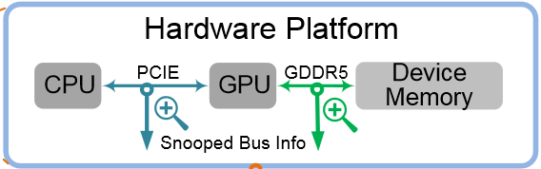
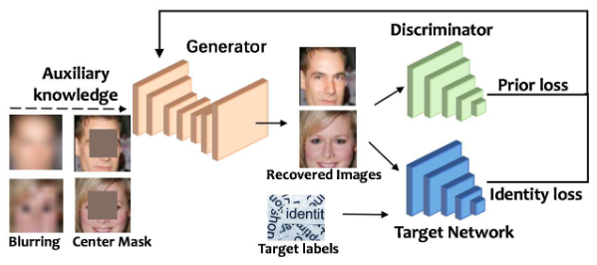
Training Data Leakage to User
    Side-Channel Attack: DeepSniffer (ASPLOS’20)
Hybrid Attack(side channel + model inversion): Hu et al. (ASPLOS’20)
obtain cache reads and writes, kernel runtime, etc., so as to infer training data
  Membership Inference Attack: Training equivalent model to determine whether a particular sample exists in the training set. Shokri et al. (S&P’17),
  Sablayrolles et al. (ICML’19)
Model Inversion Attack: SecretRevealer (CVPR’20), ModelInversion (CCS’15)
infer relations between model output and training data with common information
……
……

Slide 9
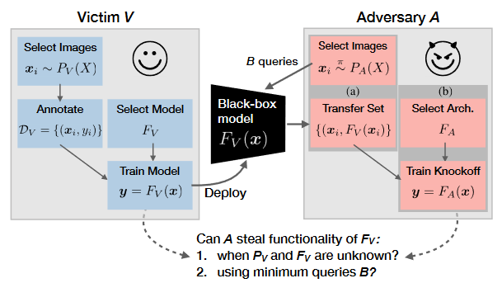
Model Parameters Leaked to User
The Equivalent Model Method: KnockoffNets (CVPR’20), Tramer et al. (Security’16), Reith et al. (WPES’19)
  Hyperparameters Theft: Essentially, it is similar to the equivalent model method. First, the training set is constructed. Then, a search is conducted in the hyperparameter space.
  Cache Telepathy (Security’20),
  Wang and Gong (S&P’18)
……
……
Obtain an approximately equivalent model using the same training algorithm and a training set particularly constructed for this purpose.

Slide 10
Protection for MLaaS Provider
Privacy-preserving model training: Make the recovery of data less effective, by distorting raw data with privacy techniques such as differential privacy.
DP-SGD (CCS’16)
Privacy-preserving model publishing: Ensure the original model can not be inversed by perturbing the model.
Yu et al. (S&P’19)
Adversarial training based defense: The adversarial training on membership inference attack is added to model training, transforming the original minimization solution into a min-max process.
Nasr et al. (CCS’18)
  Training with adversarial examples: To improve the model's ability to resist membership inference attacks, we train the model with extended data set containing adversarial examples about membership attack.
  MemGuard (CCS’18)
  Protection based on query analysis: Add a query analysis module in the user query interface of MLaaS, and stop suspicious user queries.
  PRADA (EuroS&P’19)
  The attacks and defense in the MLaaS are being actively studied. There are still many possibilities to be explored ……

Slide 11
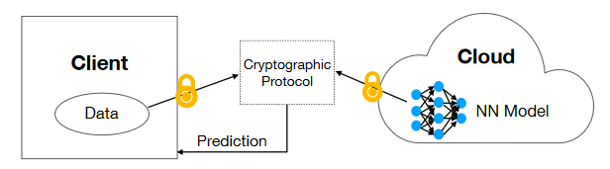
User’s Queries Leaked to Service
Need to protect:
(1) The queries;
(2) Results of queries.
Present defense approaches：
  Homomorphic Encryption based methods
      DELPHI (Usenix Security’20)
      LoLa (ICML’19)
      CryptoNets (ICML’16)
  Garbled Circuits based methods
      XONN (Usenix Security’19)
      MiniONN (CCS’17)
      Trustzone based method
      Narra et al. (arxiv’19)
DELPHI：
User and provider enforce secure computing

Slide 12
Outline
Privacy Issues in Machine Learning as a Service (MLaaS)
Adversarial Attacks
Adversarial Defense
Backdoor Attacks on Neural Networks

Slide 13
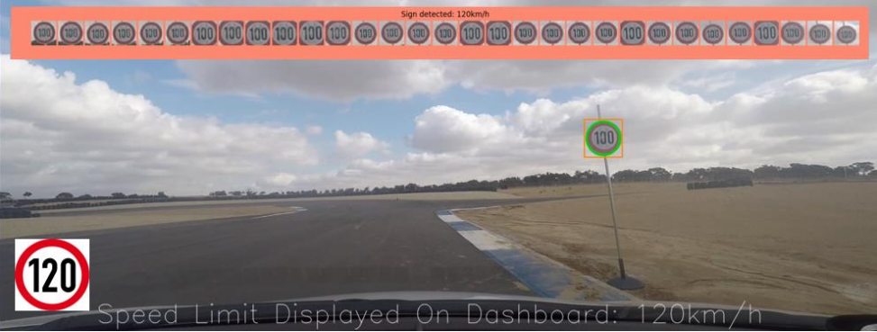
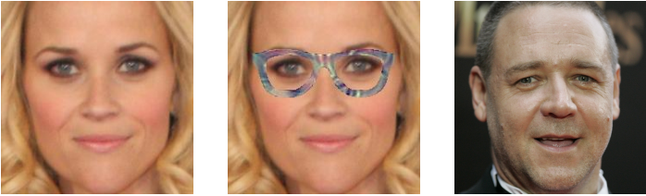
What is adversarial example
Suppose a deep neural network accurately classifies inputs with high accuracy.
Some subtle perturbations that the human vision can hardly precept are added to the inputs (so-called adversarial examples are obtained), which causes the model to give incorrect classification results with high confidence.
Limit 100km/h
Attack on the autonomous driving system
Attack on the face recognition system

Slide 14
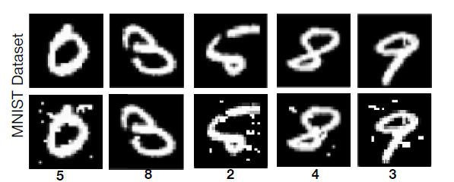
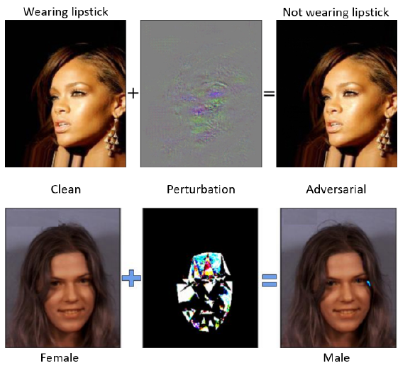
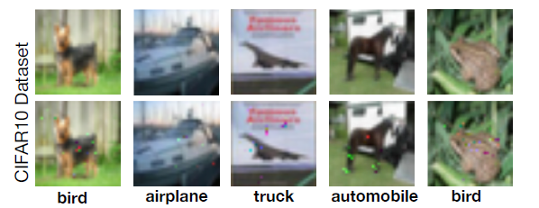
Adversarial example: characteristics
Concealment: Human eyes can hardly distinguish a perturbed picture from the original.
Violations: Adversarial examples can compromise most classification task models based on various deep neural network architectures.
Strength: The classifier can be deceived to classify the input into any class; the attacker can generate universal perturbations to make the model misclassify all possible inputs.
Transferability: The adversarial examples generated based on a particular model can also threaten the security of other similar models.

Slide 15
Attack Methods
Basic idea: Optimize the perturbation strategy towards misclassification.
  The loss function is related to the correct classification. We can make it more related to the classification we desire!
Optimization methods:
  Choose an off-the-shelf optimization method, e.g., Box-constrained L-BFGS [ICLR14]。
  Find a novel reduction of the optimization problem, e.g., Carlini-Wagner Attack method[S&P17] 。
Optimization targets:
  Untargeted attack: aims at misclassification without a specific target class.
  Targeted attack: makes the victim model classify the input into the specified class.

Slide 16
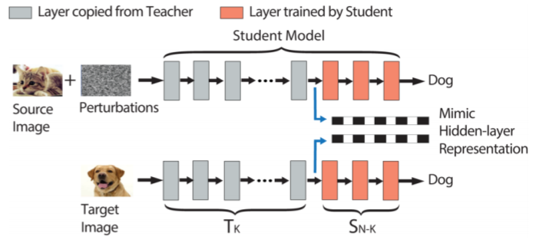
Security models
White box attack: The attacker has complete knowledge about the victim model, including the neural network architecture and the model parameters.
Black box attack: The attacker has no knowledge of the neural network architecture, parameters, or any other information of the victim model; it finds adversarial examples only by querying the victim model.
  Gray box attack: The attacker knows only the architecture of the victim model, but not the parameters.
Adversarial example attack for transfer learning—assuming that the teacher model is a white box and the student model is a black box[USENIX18]

Slide 17


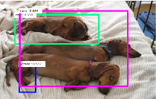

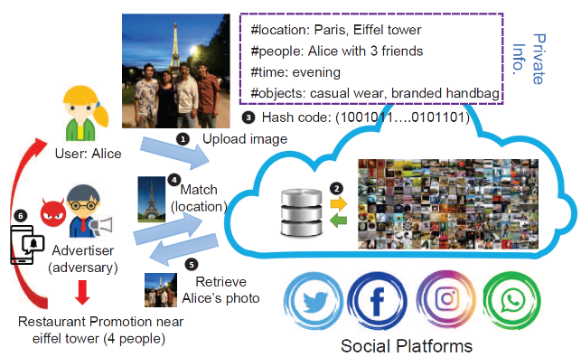
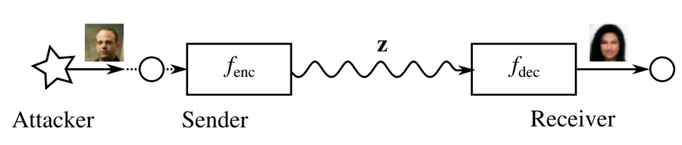
Adversarial examples: Beyond classification tasks
  Adversarial example attacks against semantic segmentation model FCN and object detection model Faster-RCNN[ICCV17]
human
train
In content-based image retrieval, the adversarial examples generated prevent images in the database from being retrieved correctly. [CVPR20]
  Generate adversarial examples against the image autoencoder (a compression algorithm). The perturbed input will be classified with a chosen wrong class label, after the encoding and decoding process.[S&PW18]

Slide 18
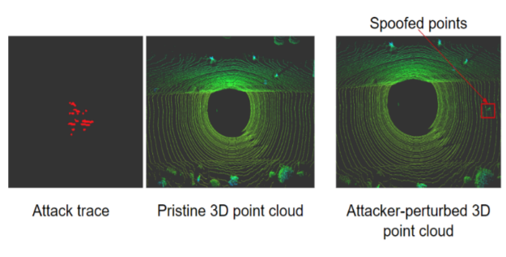
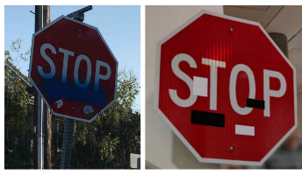
Adversarial examples: Beyond the cyberspace
Adversarial examples in the physical space—generate adversarial examples by applying physical modifications to the objects.
Adversarial example attacks on the light detection and ranging (LiDAR) system of the autonomous vehicles[CCS19]
Challenges in launching this type of attacks:
Limited lens perception;
No ability to perturb the background;
Environmental factors are highly variable;
The materials of objects also affect the attack.
Therefore, it is necessary to generate adversarial examples:
that consider multiple environmental factors and their dynamics;
that consider different angles and distances;
that limit the perturbation to a specific target (such as street signs), and replace pixel values with color blocks.

Slide 19
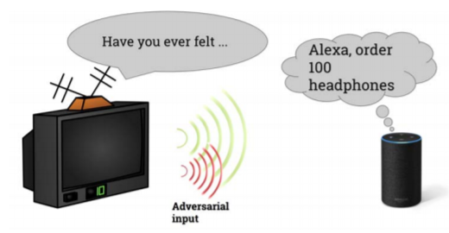
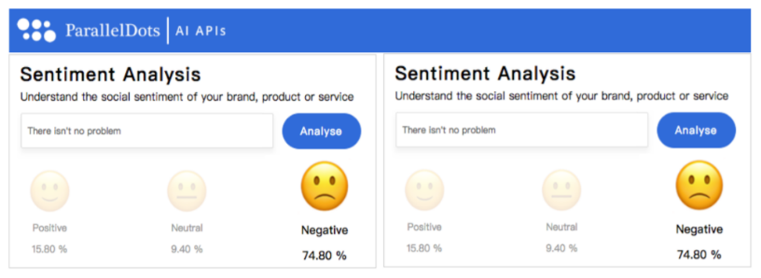
Adversarial examples: Beyond vision
Audio adversarial examples: adding into audios slight perturbation imperceptible to the human ears:
Audio transcription → Wrong output text.
Voice command → Intelligent assistant executes wrong instructions.
Natural language adversarial examples: Adding spelling errors and substitutions that are not easy to notice in the text to attack:
Emotion analysis → Manipulate arbitrarily between positive and negative emotions.
Adversarial examples of graphs: Modify graph connection information and node attribute information to make the graph-based/node-based classification fail ...

Slide 20
Outline
Privacy Issues in Machine Learning as a Service (MLaaS)
Adversarial Attacks
Adversarial Defense
Backdoor Attacks on Neural Networks

Slide 21


Adversarial Defense
Proactive Defense
Reactive Defense
Complete defense by improving models’ robustness, including:
  Heuristic Defense (Empirical Defense), such as adversarial training, and obfuscated gradients;
  Provable Defense.
Realize defense by detecting adversarial examples, including:
  Feature-based Detection;
  Model-based Detection;
  Steganalysis-based detection.

Slide 22
Heuristic Defense
Defense method | Adaptive Attack Method
Adversarial Training[1,2]
Obfuscated Gradients[3] | Backward Pass Differentiable Approximation Attacking Randomized Classifiers Reparameterization[5]
Ensemble Diversity[4] | Adaptive Attacks[6]
Main idea: take advantage of all kinds of ‘reasonable’ methods to make AEs hard to be generated, but without theoretical guarantees
[1] I. Goodfellow, J. Shlens, and C. Szegedy. Explaining and harnessing adversarial examples. In Proceedings of the 3rd ICLR, 2015.
[2] A. Madry, A. Makelov, L. Schmidt, D. Tsipras, and A. Vladu. Towards deep learning models resistant to adversarial attacks. CoRR, abs/1706.06083, 2017.
[3] Guo, C., Rana, M., Cisse, M., and van der Maaten, L. Countering adversarial images using input transformations. International Conference on Learning Representations, 2018.
[4] Pang, T., Xu, K., Du, C., Chen, N., and Zhu, J. Improving adversarial robustness via promoting ensemble diversity. In International Conference on Machine Learning, 2019.
[5] A. Athalye, N. Carlini, and D. Wagner. Obfuscated gradients give a false sense of security: Circumventing defenses to adversarial examples. 2018.
[6] Florian Tramer, Nicholas Carlini, Wieland Brendel, and Aleksander Madry. On adaptive attacks to adversarial example defenses. arXiv:2002.08347, 2020.

Slide 23
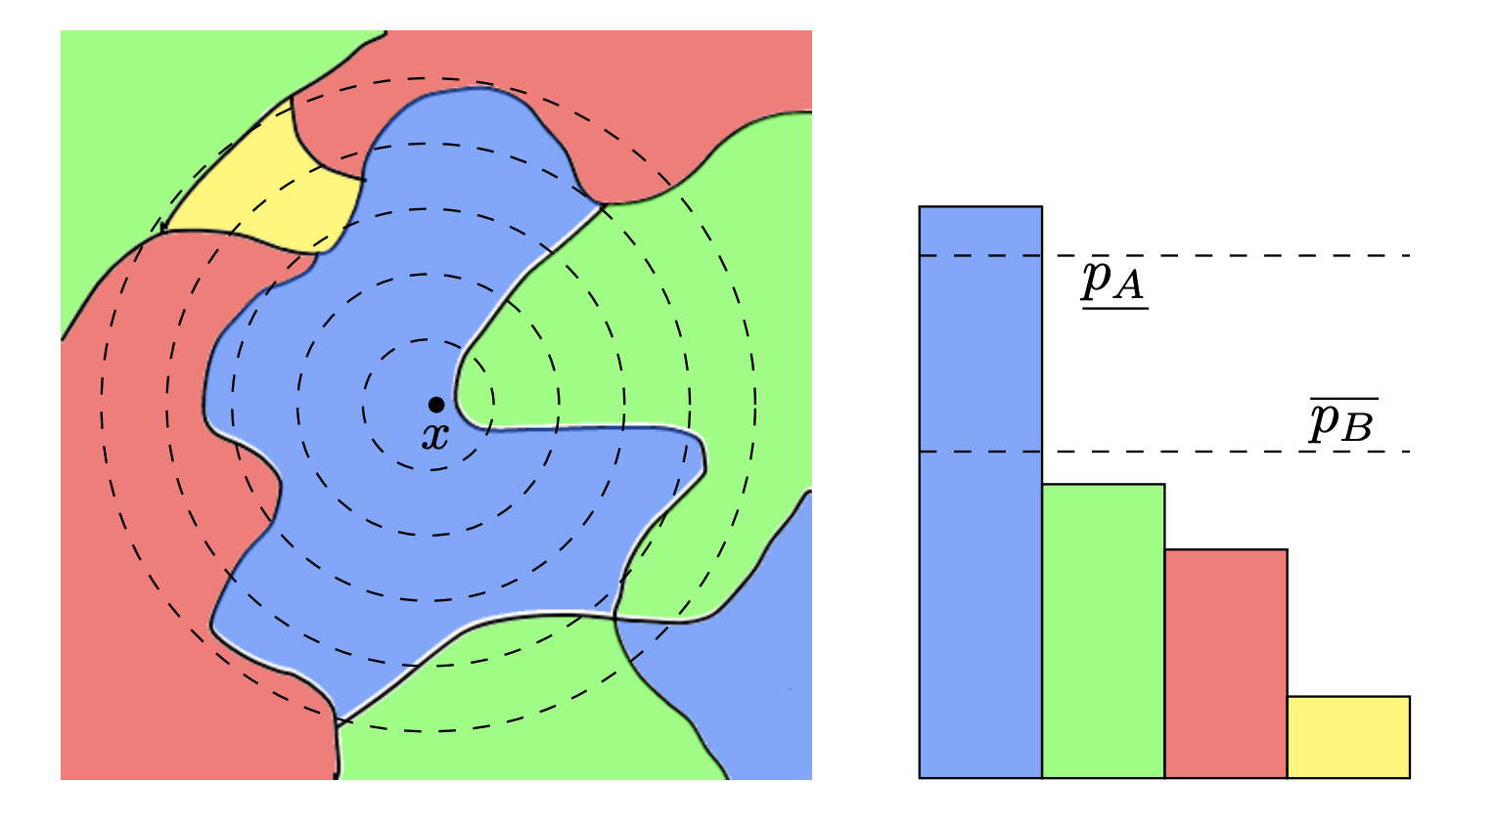
Provable Defenses
Main idea: given any inputs whose perturbation is lower than a fixed magnitude, the defense can guarantee to classify them correctly. Specific methods consists:
  Minimum distortion optimization;
  Random Smoothing.
Probability distribution of x’s output after random smoothing[2]
[1] Tjeng, V., et. al. Evaluating robustness of neural networks with mixed integer programming. In International Conference on Learning Representations, 2019.
[2] Lecuyer, M., et. al. Certified robustness to adversarial examples with differential privacy. In 2019 IEEE Symposium on Security and Privacy (SP), pp. 656–672. IEEE, 2019.

Slide 24
Minimum distortion optimization
Main idea: optimize the worst case lower bound on minimum distortion as a certified robustness metrics.(It is a NP-complete problem [1])
  Exact solution：Satisfiability Modulo Theory [2], Mixed-integer Programming [3].
  Approximate solution：Relaxation of Nonlinearity [4], Lagrange Dual [5], LP-relaxed Dual [6].
[1] Katz, G., et. al. Reluplex: An efficient smt solver for verifying deep neural networks. International Conference on Computer Aided Verification, 2017.
[2] Carlini, N, et. al. Provably minimally-distorted adversarial examples. arXiv preprint arXiv: 1709.10207, 2017.
[3] Tjeng, V., et. al. Evaluating robustness of neural networks with mixed integer programming. In International Conference on Learning Representations, 2019.
[4] Raghunathan, A, et. al. Semidefinite relaxations for certifying robustness to adversarial examples. In Advances in Neural Information Processing Systems 31, 2018b.
[5] Qin, C., et. al. Verification of non-linear specifications for neural networks. ICLR, 2019.
[6] Wong, E., et. al. Scaling provable adversarial defenses. In Advances in Neural Information Processing Systems 31, 2018.

Slide 25
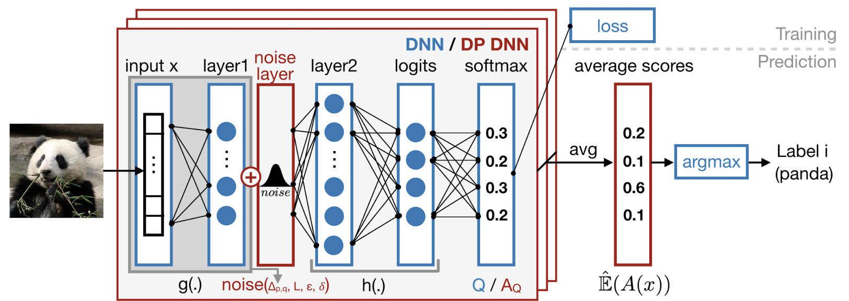
Random Smoothing
Main idea: take advantage of differential privacy and hypothesis test to prove perturbed inputs should be classified correctly with bounded distortion.
[1] Lecuyer, M., et. al. Certified robustness to adversarial examples with differential privacy. In 2019 IEEE Symposium on Security and Privacy, pp. 656–672. IEEE, 2019.

Slide 26
State-of-the-art Proactive Defenses and corresponding shortages
State-of-the-art proactive defenses
Corresponding shortages
Provable Defense: TRADES [1] （NeurIPS 2018 Adversarial Vision Challenge winner）
Minimum distortion optimization: WSMK [2]
Random Smoothing: f-divergence based Random Smoothing [3，4]
TRADES needs lots of training dataset；
WSMK only guarantees its performance on small and shallow models;
f-divergence based Random smoothing cannot extend to large norm (especially L∞).
[1] Zhang, H., et al. Theoretically principled trade-off between robustness and accuracy[J]. arXiv preprint arXiv:1901.08573, 2019.
[2] Wong, E., et al. Scaling provable adversarial defenses[C]//Advances in Neural Information Processing Systems. 2018: 8400-8409.
[3] Dvijotham, K.D. et. al. A framework for robustness certification of smoothed classifiers using f-divergences[C]. International Conference on Learning Representations. 2019.
[4] Blum, A., et al. Random smoothing might be unable to certify l∞ robustness for high-dimensional images[J]. arXiv preprint arXiv:2002.03517, 2020, 2(2).

Slide 27



Reactive Defense
Main Idea
Detection Methods
Detect AEs and weed out them.
Feature-based detection
Model-based detection
Steganalysis-based detection

Slide 28
Feature-based Detection
Main idea: find the differences between AEs and unperturbed samples as an index, and detect AEs by checking the index.
Observed Features(Differences) | limitation
The differences on parameters and variance after PCA [1] | Only effective on MNIST
The difference on output of final hidden layer [2] | Only effective on MNIST
Different patterns of ReLU activations in neural networks [3]
Output differences after some specific transforms [4, 5]
[1] Hendrycks, D. et. al. Early methods for detecting adversarial images. arXiv preprint arXiv:1608.00530, 2016.
[2] Feinman, R. et. al. Detecting adversarial samples from artifacts. arXiv preprint arXiv:1703.00410, 2017
[3] Lu, J. et. al. Safetynet: Detecting and rejecting adversarial examples robustly. In IEEE International Conference on Computer Vision, pages 446–454, 2017.
[4] Liang, B. et. al. Detecting adversarial image examples in deep neural networks with adaptive noise reduction. IEEE Transactions on Dependable and Secure Computing, 2018.
[5] Metzen, J. H. et. al. On detecting adversarial perturbations. International Conference on Learning Representations, 2017.

Slide 29
Model/Steganalysis-based Detection
Model-based Detection
Steganalysis-based Detection
Main idea: training a binary model to detect AEs.
For examples, add a new category for AEs [1]; train a cascade classifier on outputs of convolutional layers [2]; train a model on PCA’s outputs [3].
Main idea: regard adversarial perturbation as an image with steganographic signal.
For instance, Modeling the differences between adjacent pixels in natural images [4].
[1] Grosse, K. et. al. On the (statistical) detection of adversarial examples. arXiv preprint arXiv: 1702.06280, 2017
[2] Li, X. et. al. Adversarial examples detection in deep networks with convolutional filter statistics. In IEEE International Conference on Computer Vision, pages 5764–5772, 2017.
[3] Bhagoji, A.N. et. al. Dimensionality reduction as a defense against evasion attacks on machine learning classifiers. arXiv preprint arXiv:1704.02654, 2017.
[4] Liu, J. et. al. Detection based defense against adversarial examples from the steganalysis point of view.In CVPR, pages 4825-4834, 2019.
[5] Carlini, N. et. al. Adversarial examples are not easily detected: Bypassing ten detection methods. In ACM Workshop on Artificial Intelligence and Security, pages 3–14. ACM, 2017.
[6] Dong, X. et. al. Robust Superpixel-Guided Attentional Adversarial Attack. CVPR 2020.

Slide 30

State-of-the-art Detection’s Limitation
Only effective against existing adversarial attacks;
Assume detector knows how AEs are generated;
Heuristic-based method without theoretical support;
Easily fall into cat and mouse game.

Slide 31
Outline
Privacy Issues in Machine Learning as a Service (MLaaS)
Adversarial Attacks
Adversarial Defense
Backdoor Attacks on Neural Networks

Slide 32
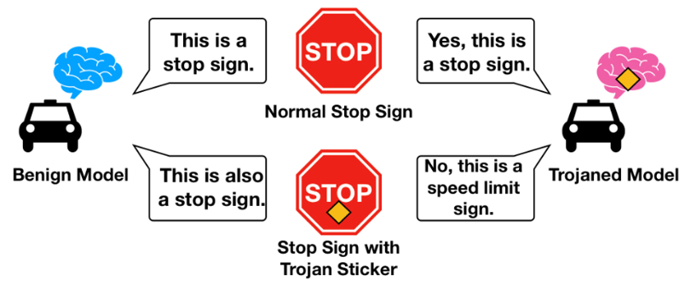
Backdoor Attacks on Neural Networks
Basic Idea: Backdoor attacks insert triggers to the machine learning models to make the system perform maliciously on the trigger instances while behaving normally in the absence of the triggers
  Normal Input→Normal Label
  Input with Trojan Sticker→ Target Label
  Use a model published by a third party
  Use training dataset provided by a third party
  Use third-party platforms for training
  Federal Learning: a training process that is not fully controlled
Risk Scenario

Slide 33
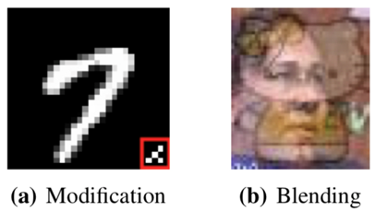
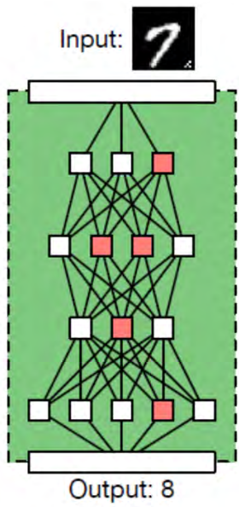
The Main Method of Backdoor Attack
Attack during the training phase---Poisoning of training data: the model trainer is the attacker :
  Modification attack: Add a trigger to part of the training data and mark it as a specified label
  Blending attack: instead of adding a trigger pattern to some part of the input, the adversary blends the pattern into the original input
  Attack on the pre-trained model---Parameter attack: this attack directly modifies the parameters of an already trained model:
  Basic Idea : In the retraining phase, by modifying specific neurons in the model, abnormal activation of the neurons is triggered to affect the output of the model.
Red is the modified neuron
The number 7 with trigger is incorrectly recognized as the number 8

Slide 34
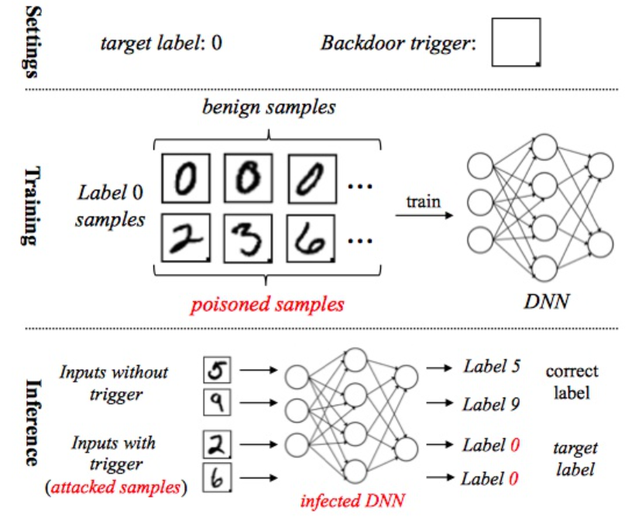
Poison-based Backdoor Attack
Set the trigger and target label (e.g. the trigger is the black square in the lower right corner in the picture on the right)
Generate poisoned samples and add them to the training dataset
Use the poisoned training dataset for training, and get a trojaned model

Slide 35
Parameter Attack
Attack Process
  Trigger generation: Design triggers based on values that would induce maximum response of specific internal neurons in the DNN.
  Training dataset generation: The attacker generates training dataset through reverse engineering, then adds a trigger to some of the data and adjusts the label of these data.
  Model retraining : The attacker builds a stronger connection between triggers and internal neurons.

Slide 36
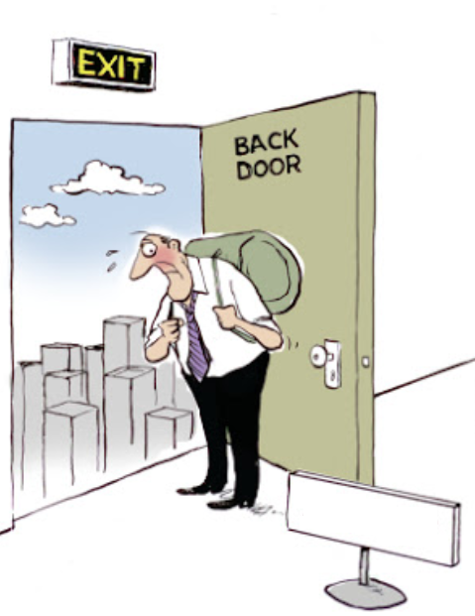
Defense Methods for Backdoor Attack
Backdoor detection based on trigger generation: Rebuild the trigger that may be used by the attacker by reverse engineering, and then determine whether the model contains a backdoor.
  Typical method: DeepInspect(IJCAI-19) Neural Cleanse(S&P-19)
Backdoor detection based on neuron scanning: Scan the model and try to find abnormal neurons to determine whether the model contains a backdoor.
  Typical method: ABS(CCS-19)

Slide 37
The Difference Between Backdoor Attack and Other Attacks
Adversarial Examples vs. Backdoor Attack
  Adversarial Examples: The model is benign, the input is malicious
  Backdoor Attack: The model is benign
  Traditional Data Poisoning Attack vs. Backdoor Attack
  Traditional Data Poisoning Attack: The purpose is to reduce the generalization performance of the model while making the model perform poorly on the test dataset
  Backdoor Attack: The performance of the normal input is close to the normal model, but the input with trigger will be classified into the target label

Slide 38



Concluding Remarks
We briefly reviewed work on three types of AI security problems: Privacy issues in MLaaS, Adverarial Examples, Backdoor Attacks on Neural Networks.
These (and other AI security problems) are worthy of further investigation.

Slide 39

THE END

