Slide 1


Decision Making Under Uncertainty for Vehicular Crowd Sensing
Haiming Jin
John Hopcroft Center for Computer Science
Shanghai Jiao Tong University
江苏省研究生“智能网络计算与信息安全”暑期学校学术报告
2021.08.20

Slide 2






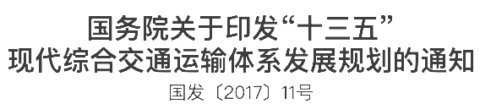
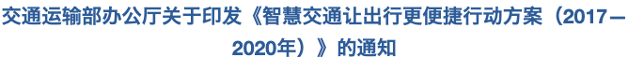

研究背景
智慧城市
2016
《中国交通运输发展白皮书（2016）》
首次发表交通发展白皮书
分析机遇与挑战，提出交通现代化建设蓝图
《推进智慧交通行动发展行动计划（2017）》
各级部委联合规划
加快完善现代综合交通运输体系，推进绿色出行
大力推进“互联网+交通运输”加快推进智慧交通发展，推动交通运输大数据开放共享
《“十三五”交通领域科技创新专项规划》
国家政策全面推进
大力推动多种运输方式一体化融合发展，加快建设“交通强国”
科技创新赋能交通运输发展，以数字化、网联化、智能化为主线，强化数据开放共享
提高运营管理的智慧化水平，打造综合交通运输“数字大脑”， 实现人享其行、物优其流
《“十四五”交通强国建设纲要》
2021
加快智慧城市建设已成为国家重大战略需求

Slide 3
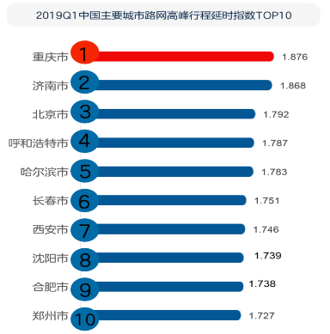
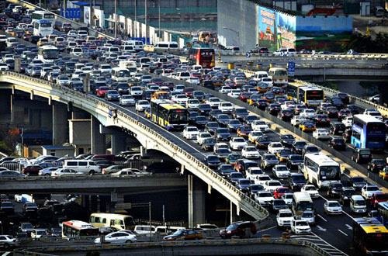
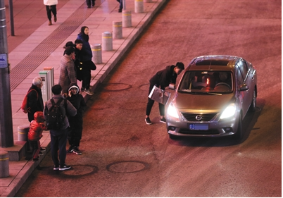
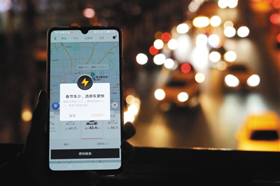
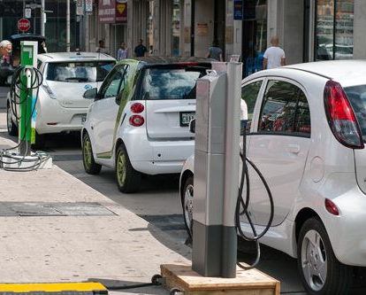
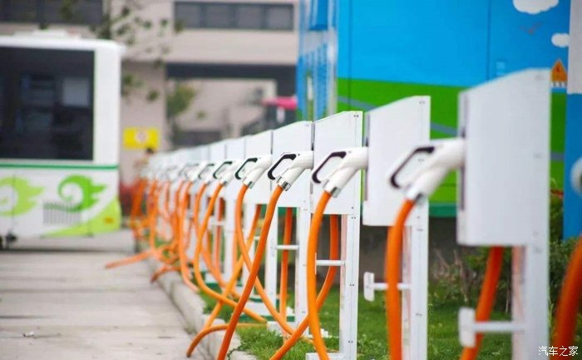
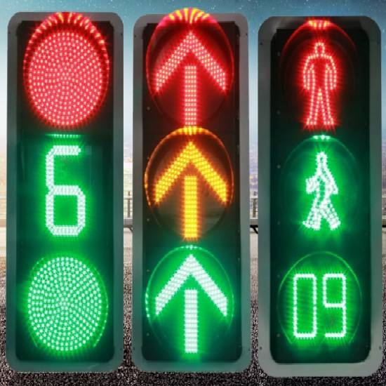
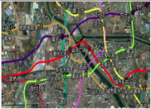
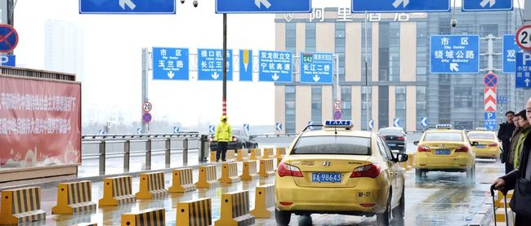


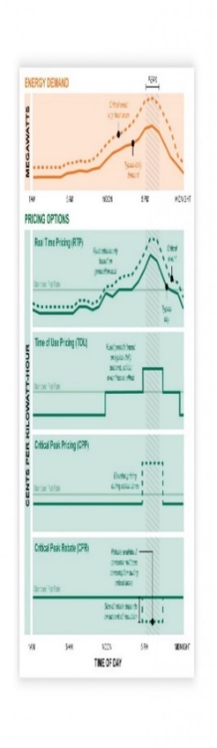


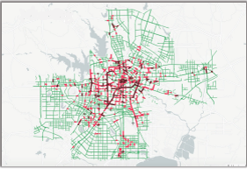
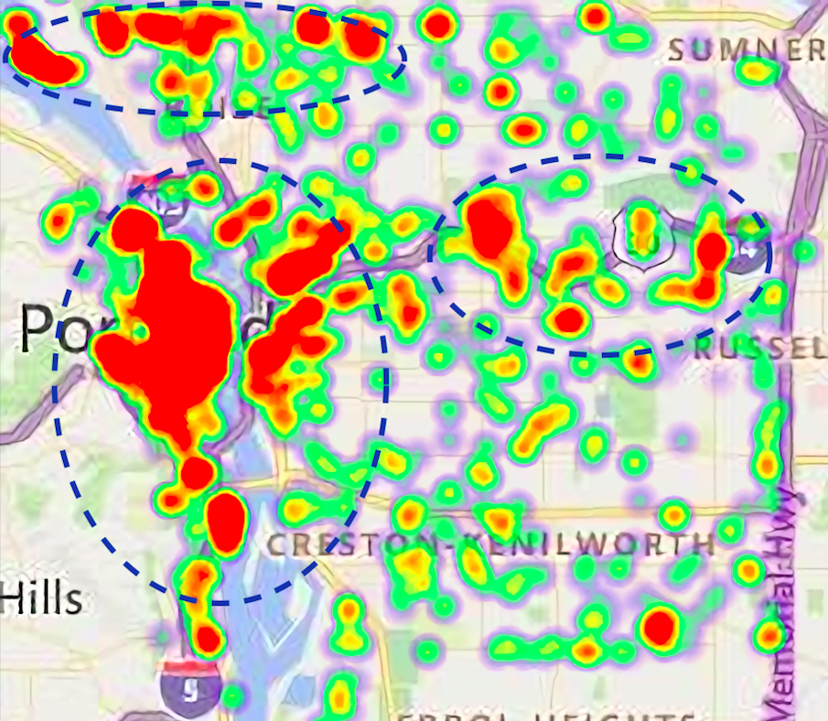
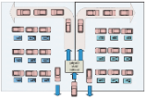
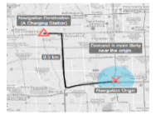













研究背景
交通拥堵严重
打车出行低效
车辆充电困难
交通拥堵造成70%以上的额外出行时间,损失约占GDP的5%
网约车打车难,夜间百人排队,等待时间长达数小时
车桩比仅为4:1,且布局不合理,公共充电桩使用率不到15%
解决 方案
解决 方案
解决 方案
信号灯调控
交通规划
车辆调度
交通流预测
充电桩部署
动态充电定价
出行方式推荐
车流预测
路线推荐
需求分析
快慢充推荐
充电需求分析
核心基础—大规模城市数据的感知与收集
道路数据
轨迹数据
其他数据
路网
卡口视频
POI
天气
出租车GPS轨迹
公交车
GPS轨迹
公共交通刷卡
电动车GPS轨迹
手机信令
手机传感器
充电桩分布
运营
Notes:
现代化的综合交通运输体系

Slide 4
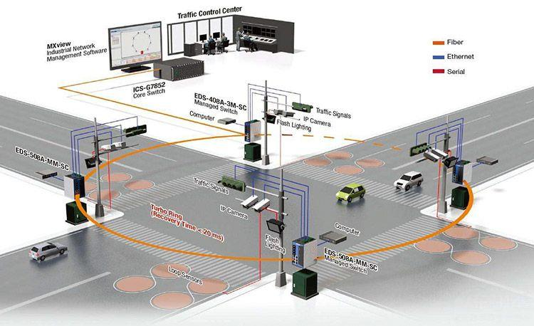
















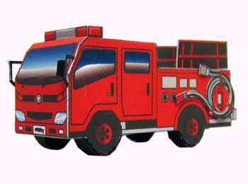



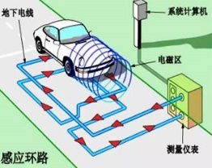
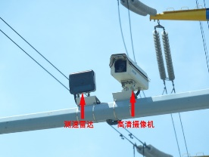
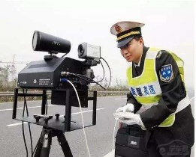
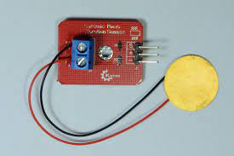











研究背景
车辆移动群智感知
传统固定传感器网络
车辆移动群智感知
群智平台
数据上传
报酬支付
任务发布
数据上传
用户1
用户2
…
用户3
大量普通用户
大规模、复杂城市感知任务
车载感知设备
线圈
摄像头
雷达
压电
城市路面坑洼感知
特点：成本高、覆盖弱
特点：部署成本低、覆盖范围广

Slide 5
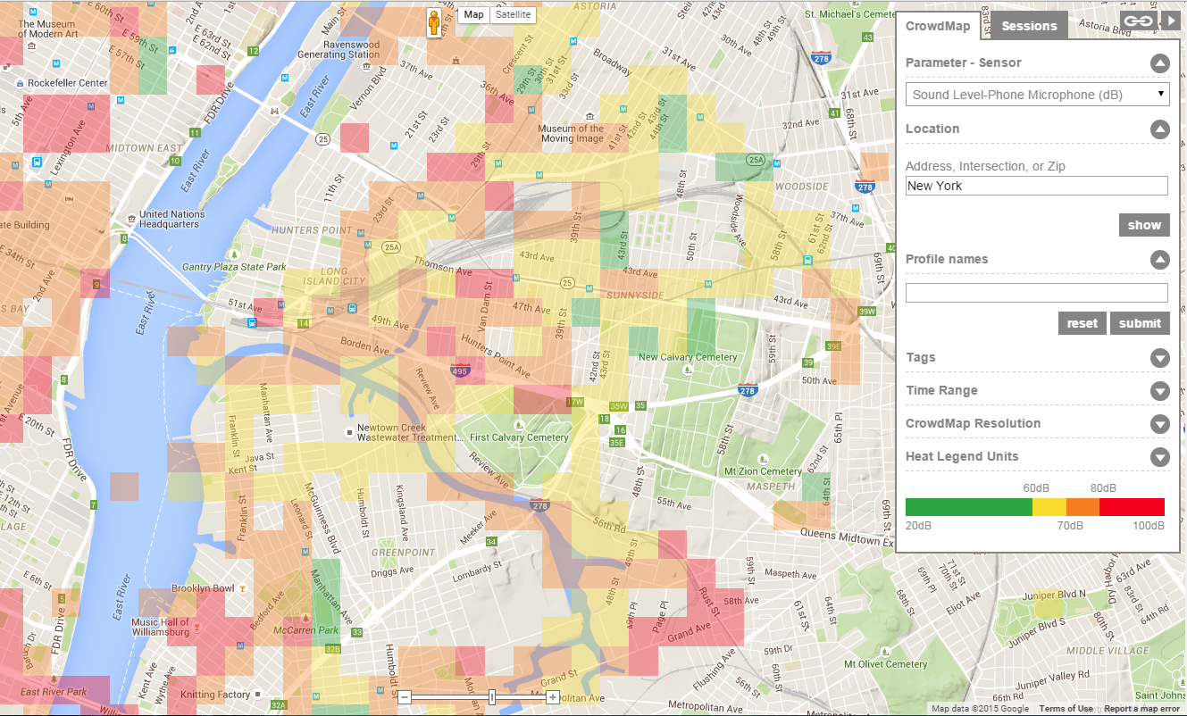
Vehicular Crowd Sensing (VCS)
Sensing Capable Vehicles
Vehicular Crowd Sensing
Environment Monitoring
Road Speed Estimation
Traffic Accident Detection

Slide 6
Uncertainties in VCS
Vehicles face highly uncertain environments
  Future sensing demands
  Sensing behaviors of other vehicles
  Road traffic conditions
  Available network resources
  …
  Appropriate decision making for vehicles to optimize system-wide sensing performance under uncertainty!
Notes:
In practice, enabling smart transportation requires the seemless integration of intelligent sensing, data processing, and control technologies.
Sensing the urban environment and collecting multi-modal sensory data (e.g., phone sensor data, …) is apparently the first step.
Leveraging the collected large-scale urban data as well as data mining and machine learning techniques, we could then discover inherent transportation patterns including crowd flow direction, preferred transportation modes, and even predict future traffic conditions.
Next, based on the discovered knowledge, we could then control transportation processes by vehicle routing, traffic light control, and so on to eventually improve the current transportation status.

Slide 7
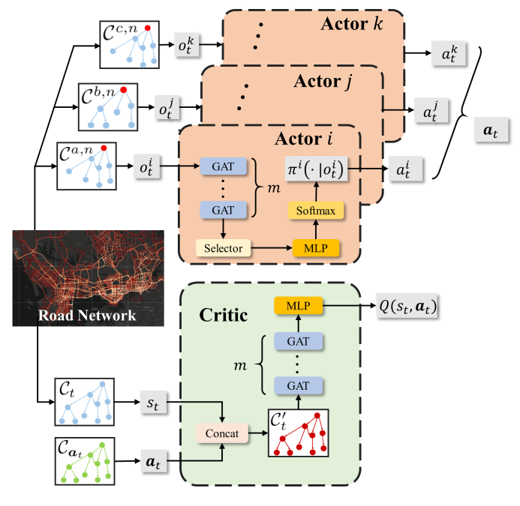
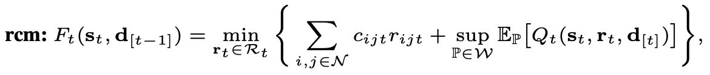
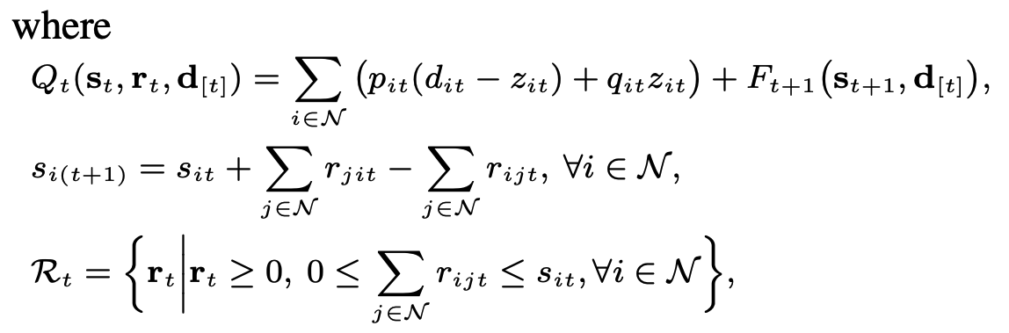

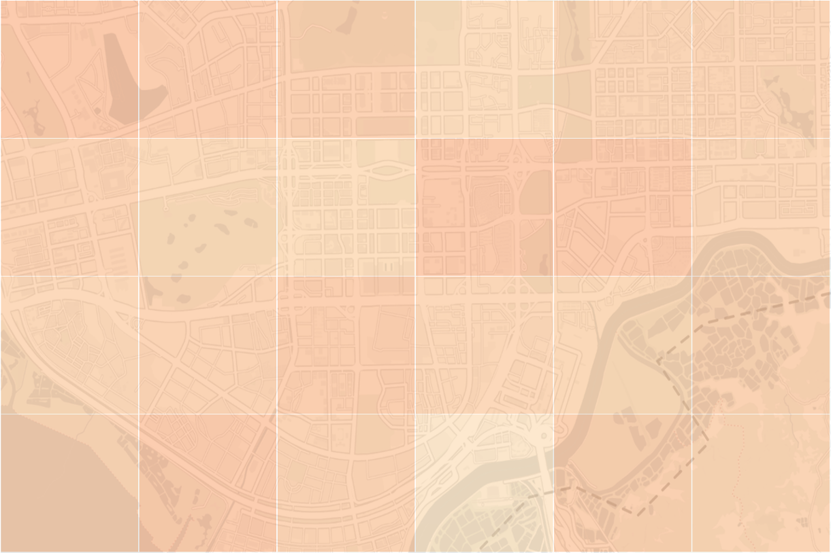

Outline
Distributed Route Selection for Vehicular Sensing with For-Hire Vehicles [1]
Fine-Grained Spatio-Temporal Coverage for Vehicular Sensing Systems [2]
Multi-Agent Reinforcement Learning
Distributionally Robust Optimization
[1] R. Ding, Z. Yang, Y. Wei, H. Jin, X. Wang, “Multi-Agent Reinforcement Learning for Urban Crowd Sensing with For-Hire Vehicles ”, in IEEE INFOCOM 2021.
[2] G. Fan, Y. Zhao, Z. Guo, H. Jin, X. Gan, X. Wang, “Towards Fine-Grained Spatio-Temporal Coverage for Vehicular Urban Sensing Systems”, in IEEE INFOCOM 2021.
Notes:
车辆共享系统的联合订单分配与车辆调度问题
分布式大规模电出租系统管理算法设计

Slide 8
Outline
Distributed Route Selection for Vehicular Sensing with For-Hire Vehicles [1]
Fine-Grained Spatio-Temporal Coverage for Vehicular Sensing Systems [2]
Multi-Agent Reinforcement Learning
Distributionally Robust Optimization
[1] R. Ding, Z. Yang, Y. Wei, H. Jin, X. Wang, “Multi-Agent Reinforcement Learning for Urban Crowd Sensing with For-Hire Vehicles ”, in IEEE INFOCOM 2021.
[2] G. Fan, Y. Zhao, Z. Guo, H. Jin, X. Gan, X. Wang, “Towards Fine-Grained Spatio-Temporal Coverage for Vehicular Urban Sensing Systems”, in IEEE INFOCOM 2021.
Notes:
车辆共享系统的联合订单分配与车辆调度问题
分布式大规模电出租系统管理算法设计

Slide 9
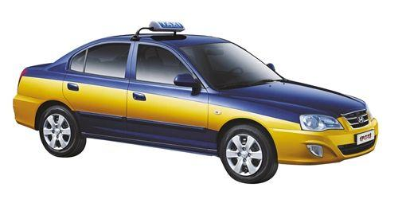
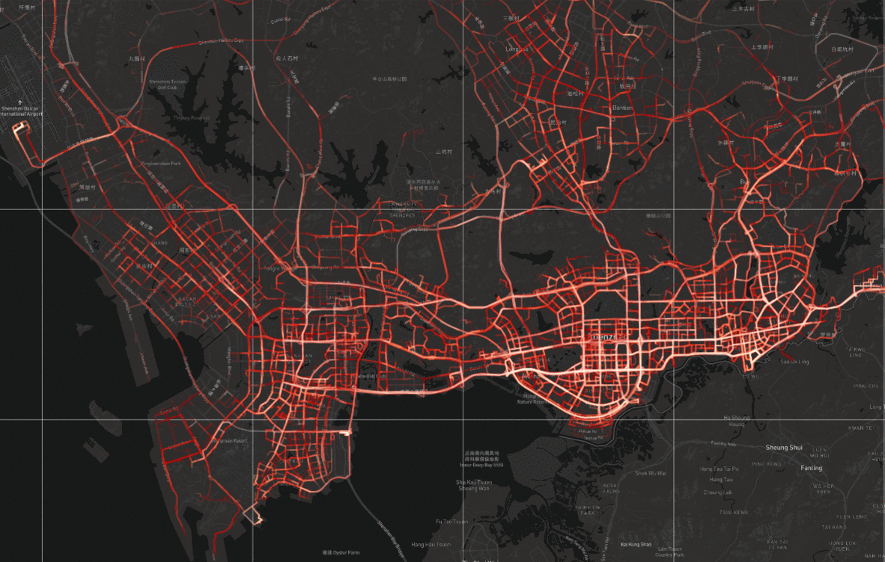
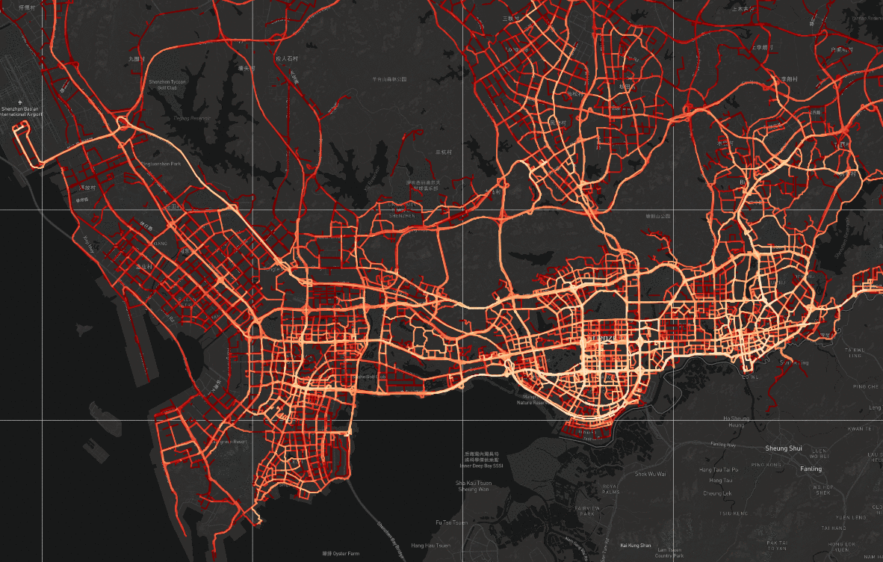
Motivation
For-hire vehicles (FHVs) are the most desirable forces
for many VCS tasks.
Air Quality Sensing
Front-View Driving Video Collection
DiDi Map Updating
Taxis, Uber, Didi, etc.
Specialized Air Quality Sensors
Networked Dashcam
DiDi Navigation Software
FHVs concentrate around commercial areas to serve orders.
Sensing coverage requires FHV distributed evenly in the city.
Conflicting Objectives!
commercial area

Slide 10
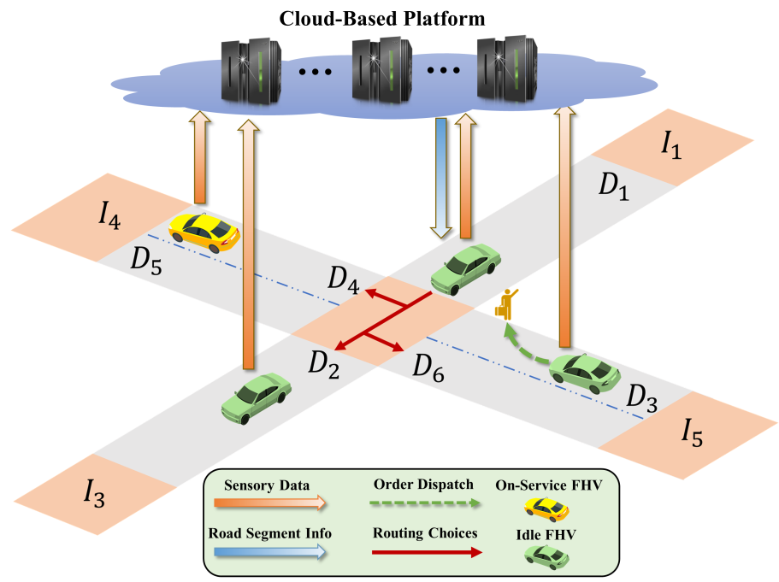
Problem Description
Route Selection
Mechanism
Centralized decision-making is infeasible due to explosion of the state and action spaces!
Distributed Mechanism
Each FHV makes its local routing decisions, while working cooperatively to jointly optimize the system-wide sensing and order-serving outcomes.
Multi-Agent Reinforcement Learning

Slide 11
Problem Formulation
FVCS-POMDP
  Agent $𝒩=\{1,2,⋯,N\}$. Decision module implemented on an FHV.
  State $s_{t}$. Current time slot $t$, features of all the road segments.
  Observation $o_{t}^{i}$. Features of the current located road segment and those can be reached in $m$ routing actions.
  Action $a_{t}^{i}$. Which road segment to go. $a_{t}$ is the joint action of all the agents.
  Policy $π_{i}(a_{t}^{i}|o_{t}^{i})$. Probability distributions over actions.
  Reward $R_{t}=r_{t}^{o}+{λr}_{t}^{s}$. System utility of that time slot.
  State Transition Probability $P(s_{t+1}|s_{t},a_{t})$.
Notes:
The FVCS-POMDP is a decentralized partially observable Markov decision process defined by following components.
Agent: We have a set of N agents.
State: The whole city road networks’state at time slot t is represented by $s_t$. $s_t$ consists of the current time slot t, and the features of each road segment.
Observation: The observation of agent i, $o^i_t$, contains the features of its current road segment and those that can be reached within m steps of routing actions by agent i.
Action: At each time slot, if agent i is leaving one intersection, it will take the action $a_t^i$ to choose which road segment to go at the next time slot.
Policy: Given observation $o^i_t$, agent i’s policy $\pi_i$ specifies a probability $\pi_i(a_i^t|o_i^t)$, with which it takes each action $a_t^i$ .
Reward: At every time slot t, the platform receives an immediate reward $R_t = r_t^o+\lambda r_t^s$, which consists of two parts of team rewards that are decided by agents’ joint actions and the current state.

Slide 12
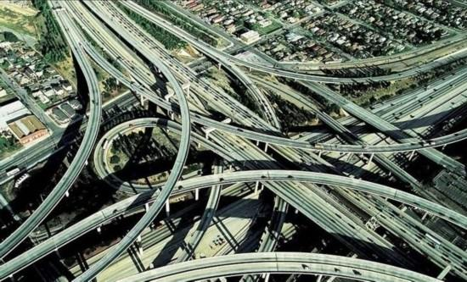
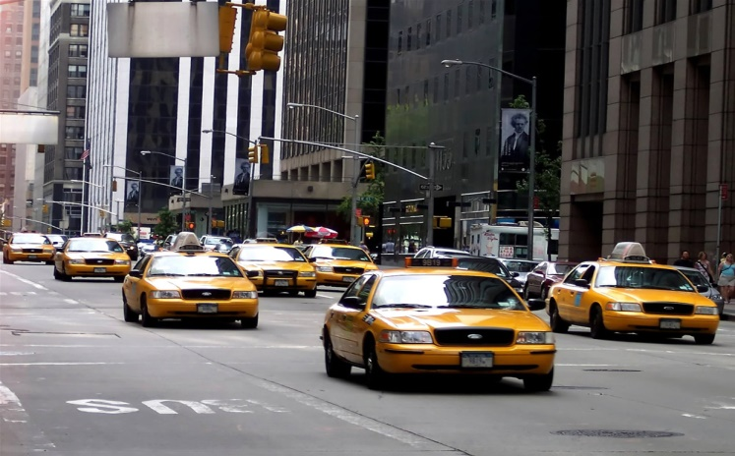

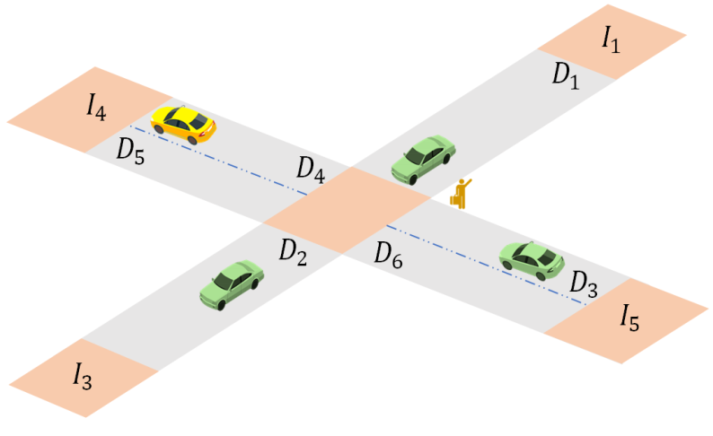
Challenges
Complicated topology
Variant agent scale
Full Cooperation
How to efficiently encode and process the information of city road network?
How to deal with the variant agent scale?
How to learn agents’ policies that can achieve full cooperation?
Notes:
In order to elaborate the GCC-MARL framework, Let me first introduces the key technological challenges that must be solved. The first challenge is that the large-scale road network of a modern city typically has a rather complicated topology, making it difficult to extract useful spatial features that are necessary to help the FHVs make appropriate routing decisions. [click] Then how can we efficiently encode and process the information of city road network with complicated topology, in order to help the FHVs make appropriate routing decisions? [click] The answer is, we can construct a special data structure, namely reachability graph, and use Graph Neural Networks to extract features of road segments from it.

Slide 13
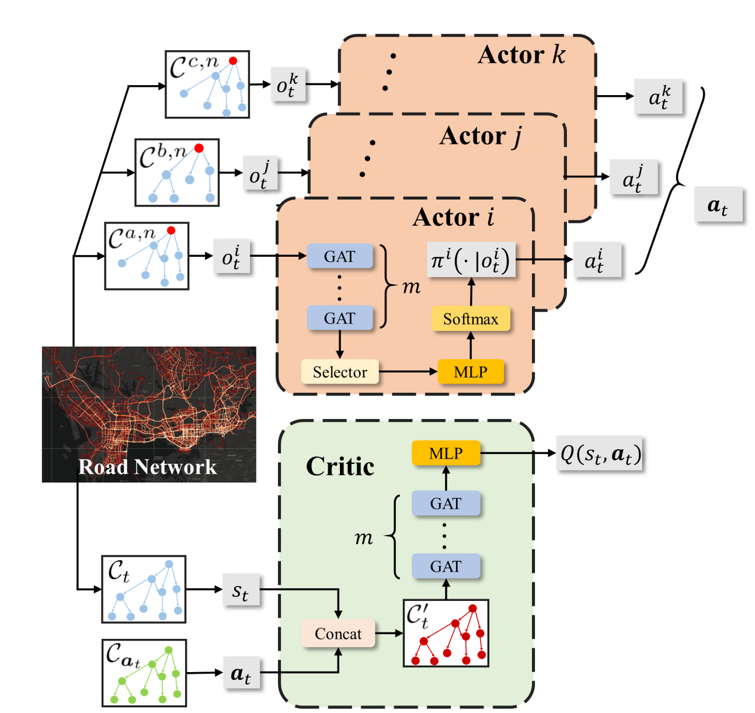
GCC-MARL Framework
N-hop subgraph: local observation.
Select routes according to the local observations.
Make decisions in a fully decentralized manner.
Reachability graph:
the global state of the environment.
Has access to the global state.
Perform credit assignment to stimulate agents to maximize the system utility.
Action graph:
graph representation of agents’ joint actions.
Graph attention networks: capture graph-structured correlations.

Slide 14
Addressing Challenge 1-Road Network Encoding
How to efficiently encode and process the information of city road network?
n-hop subgraphs
GCN
Construct reachability graph and n-hop subgraphs to capture the reachability relationship between road segments.
reachability graph
GCN
Use Graph Convolutional Networks (GCN) to process the features of graphs.
Notes:
An FHV’s current route selection inevitably affects the set of road segments it can reach in the future, and influences the long-term system utility. It is thus critical for the FHVs to know the reachability relationships among road segments. Thus, for a city’s road network, we can construct the reachability graph to capture such reachability information. The reachability graph $C_t$ is defined as follows.
…
Similarly, for agent i locating on road segment $D_a$, we can construct the n-hop subgraph that captures the features of its n-hop neighborhoods.
…

Slide 15
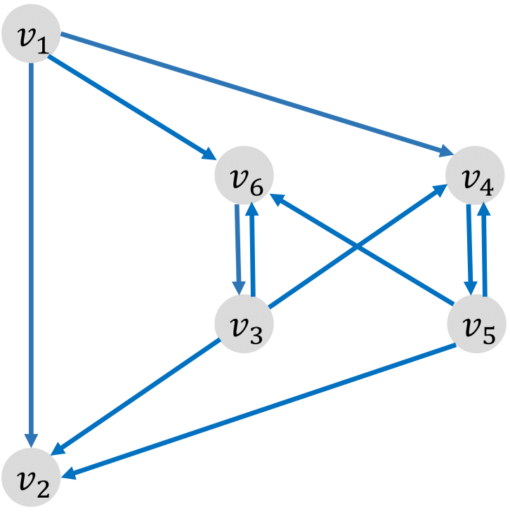
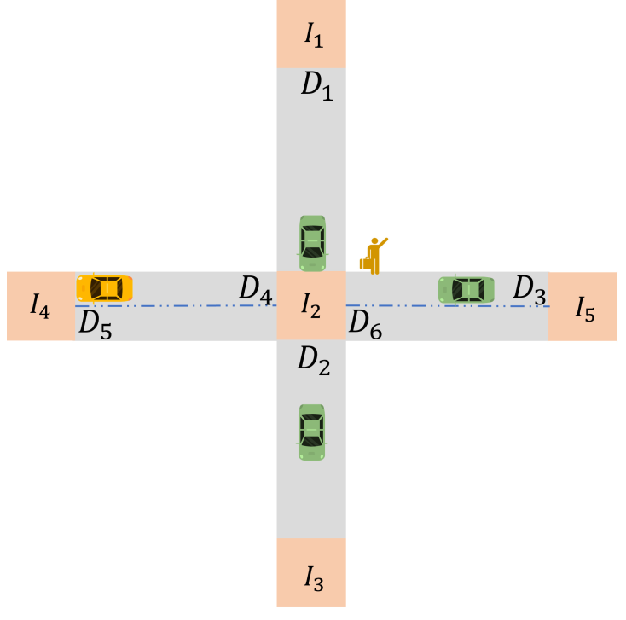
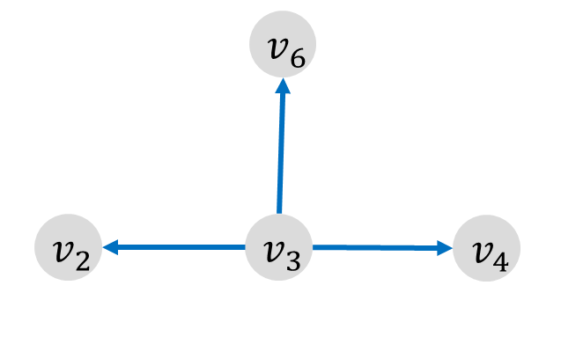


Addressing Challenge 1-Road Network Encoding
Proposed GCC-MARL Framework：Solution to Challenge 1
How to efficiently encode and process the information of city road network?
reachability graph
Road segment $⟺$ Node
Features of road segment $⟺$ Node features
Reachability relations between road segments $⟺$ Edge
n-hop subgraph $(n=1)$
Notes:
An FHV’s current route selection inevitably affects the set of road segments it can reach in the future, and influences the long-term system utility. It is thus critical for the FHVs to know the reachability relationships among road segments. Thus, for a city’s road network, we can construct the reachability graph to capture such reachability information. The reachability graph $C_t$ is defined as follows.
…
Similarly, for agent i locating on road segment $D_a$, we can construct the n-hop subgraph that captures the features of its n-hop neighborhoods.
…

Slide 16
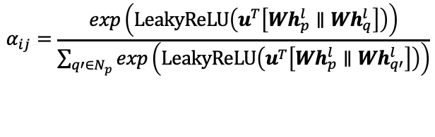


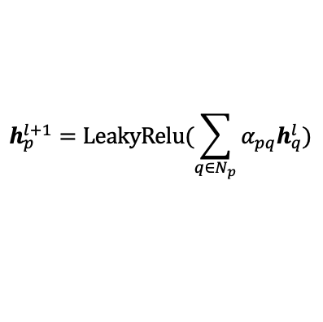
Addressing Challenge 1-Road Network Encoding
How to efficiently encode and process the information of city road network?
${(l+1)}^{th}$ GAT
$l^{th}$ GAT
We use Graph Attention Networks (GAT) to extract features of nodes.
GAT calculates dynamic attention weights according to node features.
$$α_{ij}=\frac{exp\left(LeakyReLU\left(u^{T}\left[Wh_{p}^{l}∥Wh_{q}^{l}\right]\right)\right)}{\sum_{q′∈N_{p}}{exp\left(LeakyReLU\left(u^{T}\left[Wh_{p}^{l}∥Wh_{q′}^{l}\right]\right)\right)}}$$
Node features are updated by aggregating the features of its neighborhood.
$$h_{p}^{l+1}=LeakyRelu(\sum_{q∈N_{p}}{α_{pq}h_{q}^{l}})$$
Notes:
Inspired by the recent success of graph covolutional networks on capturing graph-structured correlations, we use one kind of GCNs, Graph Attention Networks, to aggregate and process features of the constructed graphs. GAT updates the features of a node by aggregating the features of its neighborhood. Suppose $h_p^l$ and $h_q_l$ are the features of node p and its neighbor node q before the l-th GAT layer. The attention coefficient of p,q is calculated by this equation[click] . After calculating the attention coefficients between p and its neighborhoods, the features of p is updated following this equation [click].

Slide 17
Addressing Challenge 2-Action Graph
How to deal with the variant agent scale?
Construct the action graph to represent the joint action of agents
  Fixed graphical structure
  Captures the spatial properties of agents’ joint action
action graph
Notes:
The high level idea is that we can use a fixed graph structure to capture the spatial characters of the joint action of variant agents by meticulously exploring the semantics of the action space. The action graph $C_a_t$ is defined as follows.
…
.

Slide 18




Addressing Challenge 2-Action Graph
How to deal with the variant agent scale?
Road segment $⟺$ Node
Number of times that a road segment picked in $a_{t}$ $⟺$ Node features
Reachability relations between road segments $⟺$ Edge
action graph
Notes:
The high level idea is that we can use a fixed graph structure to capture the spatial characters of the joint action of variant agents by meticulously exploring the semantics of the action space. The action graph $C_a_t$ is defined as follows.
…
.

Slide 19

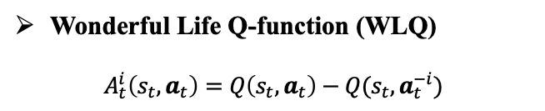
Addressing Challenge 3-Difference Reward
How to learn agents’ policies that can achieve full cooperation?
Utilize the difference reward technique to perform credit assignment among agents.
Decentralized routing decision mechanism
Wonderful Life Q-function (WLQ)
$$A_{t}^{i}\left(s_{t},a_{t}\right)=Q\left(s_{t},a_{t}\right)−Q(s_{t},a_{t}^{−i})$$
System level
non-decomposable team reward
Notes:
The FHVs of the FVCS system are supposed to work cooperatively to maximize the system utility.[click] However, the non-decomposable team reward makes it difficult to distinguish the contribution of each individual agent to the system utility, and thus hinders the effective learning of agents’ policies. In order to solve such problem, We utilize the difference reward technique to perform credit assignment among agents. Specifically, we use a simple yet effective difference reward called Wonderful Life Q-function (WLQ), which is defined as [click]
$$A_{t}^{i}\left(s_{t},a_{t}\right)=Q\left(s_{t},a_{t}\right)−Q(s_{t},a_{t}^{−i})$$

Slide 20
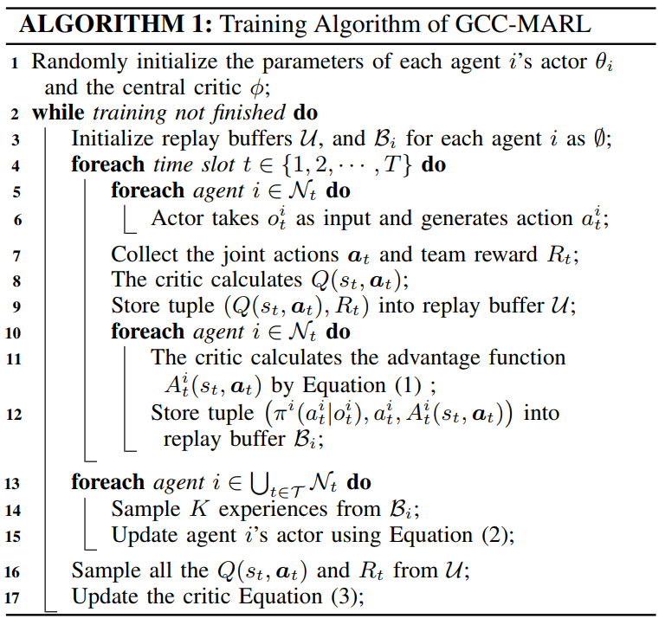
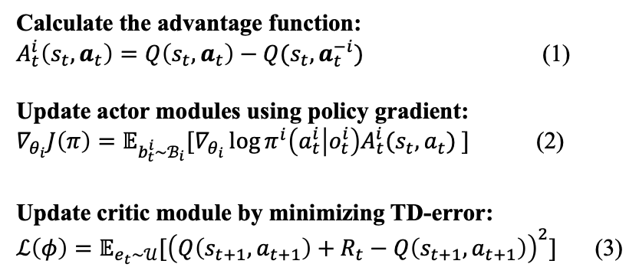
Training Algorithm
Calculate the advantage function:
$A_{t}^{i}\left(s_{t},a_{t}\right)=Q\left(s_{t},a_{t}\right)−Q(s_{t},a_{t}^{−i})$ (1)
Update actor modules using policy gradient:
$∇_{θ_{i}}J\left(π\right)=𝔼_{b_{t}^{i}\sim ℬ_{i}}[∇_{θ_{i}}\log{π^{i}\left(a_{t}^{i} | o_{t}^{i}\right)A_{t}^{i}(s_{t},a_{t}) }]$ (2)
Update critic module by minimizing TD-error:
$ℒ\left(φ\right)=𝔼_{e_{t}\sim 𝒰}[{\left(Q\left(s_{t+1},a_{t+1}\right)+R_{t}−Q\left(s_{t+1},a_{t+1}\right)\right)}^{2}]$ (3)
1
2
1
Initialize the network parameters.
2
Collect experiences.
3
3
Update the network parameters.
Notes:
Finally, we get the training algorithm of GCC-MARL framework that learn agents’ policies, which achieve full cooperation and maximize the system utility. Generally, the algorithm is divided into 3 parts: Initialize the parameters [click] collect experiences [click] and update the network parameters. [click]

Slide 21
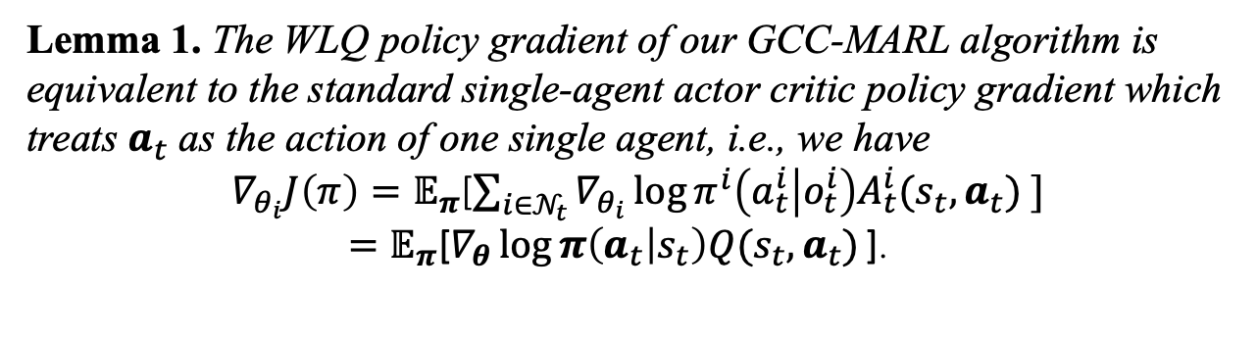
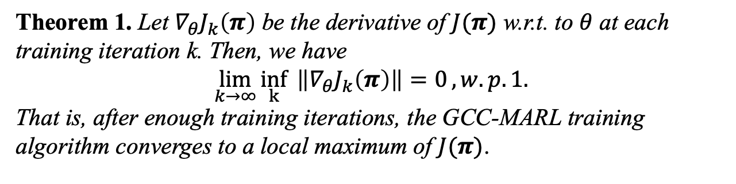
Convergence of Training Algorithm
Lemma 1. The WLQ policy gradient of our GCC-MARL algorithm is equivalent to the standard single-agent actor critic policy gradient which treats $a_{t}$ as the action of one single agent, i.e., we have
${ ∇}_{θ_{i}}J\left(π\right)=𝔼_{π}$[$\sum_{i∈𝒩_{t}}{∇_{θ_{i}}\log{π^{i}\left(a_{t}^{i} | o_{t}^{i}\right)A_{t}^{i}(s_{t},a_{t}) }]}$
$=𝔼_{π}\text{[}∇_{θ}\log{π\left(a_{t} | s_{t}\right)Q(s_{t},a_{t})}\text{]}$.
Theorem 1. Let $∇_{θ}J_{k}\left(π\right)$ be the derivative of $J(π)$ w.r.t. to $θ$ at each training iteration k. Then, we have
$$\lim_{k→∞}{\inf_{k}{ \left\|∇_{θ}J_{k}\left(π\right)\right\|=0}, w.p. 1.}$$
That is, after enough training iterations, the GCC-MARL training algorithm converges to a local maximum of $J(π)$.
Notes:
We can further yields Lemma 1, which proves that GCC-MARL training algorithm is actually equivalent to the standard single-agent actor critic policy gradient. [click] Based on Lemma 1, we can prove in Theorem 1 that finally the training algorithm will converge to a local maximum of the system utility $J(\pi)$.

Slide 22
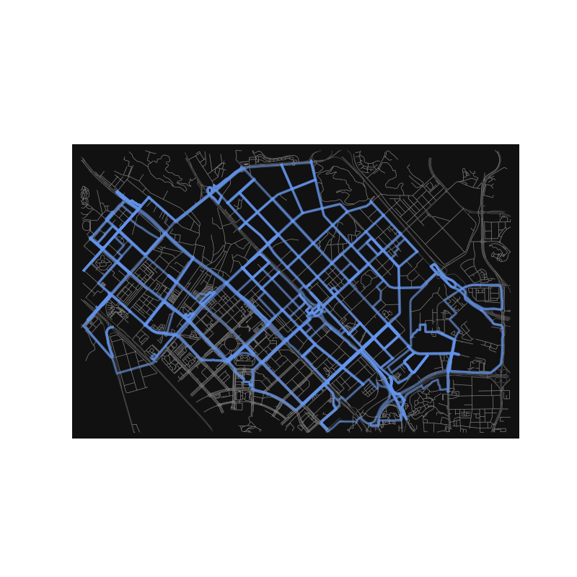
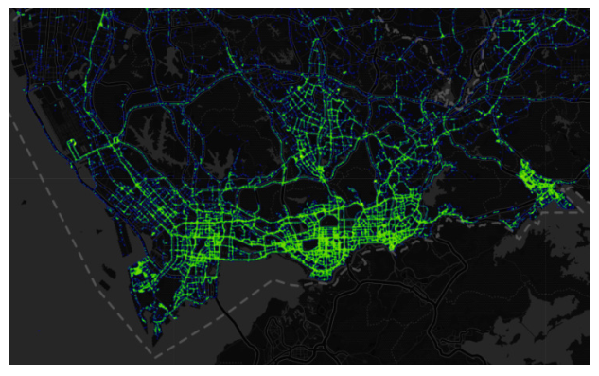
Experiment-Setting
We conduct the experiments on a city-scale simulator.
  The simulator contains the main road networks in Nanshan District, Shenzhen.
  101 intersections
  174 road segments
The simulator use part of a dataset and contains
  1,000,000+ trajectories of 553 taxis in Shenzhen
  50,000+ orders per-day
  From June 1st to June 30th, 2017
Baseline Approach
  Rule-based
  Independent Actor Critic (IAC)
  Central-V
  Learn Individual Intrinsic Reward (LIIR)
Notes:
Now, let me introduce you the experiment part. We conduct the experiments on a city-scale simulator. The simulator uses the real world data of 1,000,000+ trajectories, 50,000+ orders per-day of 553 taxis from June 1st to June 30th, 2017. These data are sampled from one of the world’s largest dataset of taxis’ trajectories in Shenzhen. We plot all the taxis’ trajectories in this dataset in the upper right figure. In our simulator, we use 3 different environment settings, each of which consists 11109, 33327 and 55545 orders correspondingly.
The simulator contains 174 road segments, 101 intersections in Nanshan District, Shenzhen. The road network topology is shown in the lower right figure.
凑合，不清晰

Slide 23
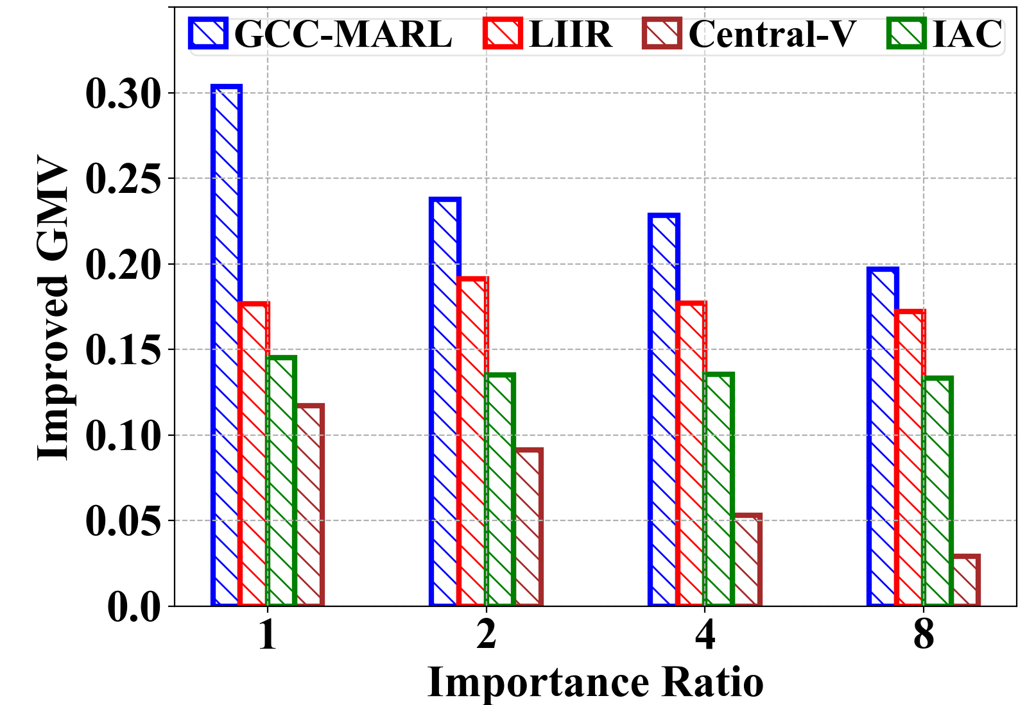
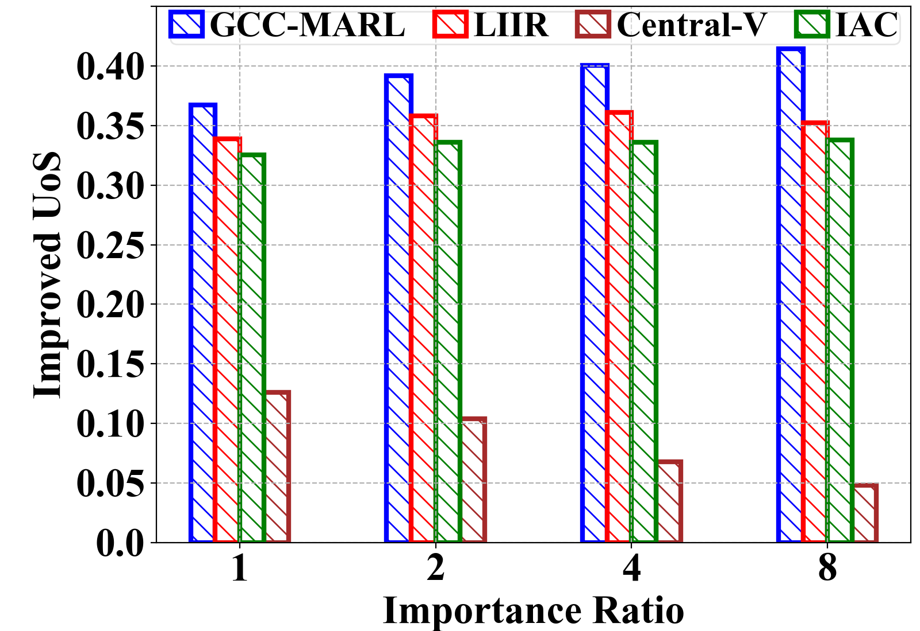
Experiment-Results
  Our proposed GCC-MARL outperforms all the baselines in both GMV and UoS in all settings.
Notes:
The baselines we compared with are rule-based method, independent actor critic, central-v and LIIR.
With rule-based method, an FHV always chooses from the candidate road segment that has the maximum average order-serving revenue.
In independent actor critic, An FHV’s reward consists of its own order-serving reward and sensing reward multiplied by an importance ratio. IAC maintains a decentralized critic for each FHV to evaluate its own long-term reward that it aims to maximize.
Central-V is identical to GCC-MARL except that it does not use the technique of credit assignment approach in training process.
LIIR is a state-of-the-art multi-agent reinforcement learning method for credit assignment.
We plot the relative improvement on GMV and UoS of IAC, Central-V, LIIR and GCC-MARL compared with Rule-based algorithm. We can easily observe that GCC-MARL outperforms all the baselines in both GMV and UoS in all settings.

Slide 24
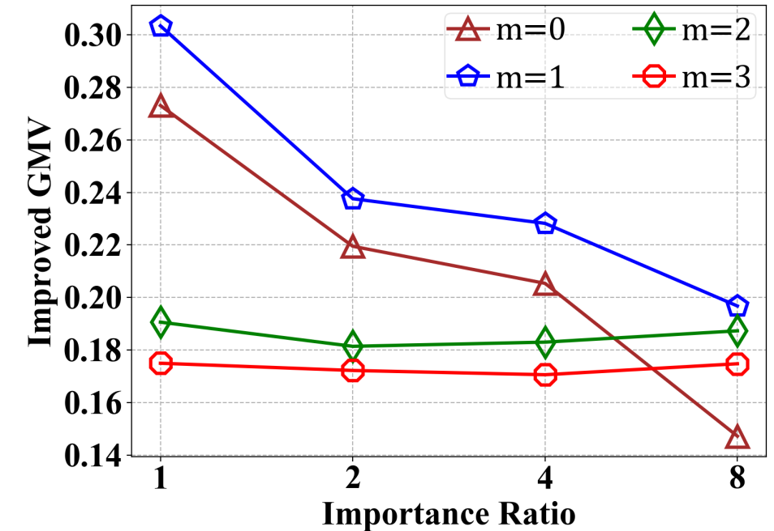




Experiment-Results
Impact of the number of GAT Layers $(m)$ in GCC-MARL
  Models with $m=1$ yield the best performance.
  Models with $m=0$ cannot capture any spatial correlation among the road segments
  Models with $m=2$ or $m=3$ bring in outdated features of overly distant road segments.
Notes:
Next, we evaluate the impact of the number of GAT layers on the performance of GCC-MARL. The figures show the performances of GCC-MARL in different settings with the number of layers $m\in{1,2,3,4}$. From the figures we observe that setting m=1 yields the best results. Models with m=0 cannot capture any spatial correlation among the road segments and thus performs worse than that with one GAT layer. Interestingly, we observe that m = 2 and m = 3 yield the worst performances in GMV and UoS among most cases. Reasons behind such observation are as follows. On one hand, the increase of the number of convolutional layers will make GCNs more likely to generate over-smoothed features, which will cause the loss of necessary spatial information and eventually hinder the generation of satisfactory policies. On the other hand, although more GAT layers would propagate features of roads in further expanded neighborhoods, the information from roads that are overly distant may become useless or even noisy for generating policies due to rapidly changing real-world road conditions

Slide 25


Experiment-Results
Evaluation of Credit Assignment Method
  Demand-Supply Gap (DSG) is the number of orders minus the number of idle FHVs on the road segment.
  Sensing Ratio (SR) is the length of the road segment divided by the number of FHVs on that road segment.
Notes:
As our credit assignment method is the core for training each agent’s actor module, we now turn to evaluate its effectiveness. We define Demand-Supply Gap (DSG) as the number of orders minus the number of idle FHVs on the road segment, and Sensing Ratio (SR) as the length of the road segment divided by the number of FHVs on that road segment.
Intuitively, a higher credit should be assigned to an FHV, if it drives to a road segment with a larger DSG, since it is more likely to serve orders. Similarly, FHVs driving to a road segment with a larger SR will contribute more to the sensing outcome, and thus should also be assigned a higher credit. In the figure, we show the average normalized WLQ w.r.t. both the DSG and SR with $\lambda \in {1,2,4,8}$. The general increasing trend of the curves conforms with the above intuition, and
validate the correctness of our credit assignment method

Slide 26




Experiment-Results
GCC-MARL
Central-V
Order
Serving
Sensing

Slide 27
Summary of Part 1
Problem:
We identify the unique challenges of urban crowd sensing with for-hire vehicles, and propose to design a routing selection mechanism to maximize the system utility of the VCS system.
Methodology:
  We formulate the routing selection problem of FHVs as a multi-agent reinforcement learning problem, where FHVs work cooperatively to maximize the overall team reward.
  To solve this problem, we propose a novel graph convolutional cooperative multi-agent reinforcement learning (GCC-MARL) framework.
Experiment:
We perform extensive experiments using one city-scale real-world FHV dataset, which consists of 1,000,000+ trajectories of 553 e-taxis and 50,000+ orders per day, from June 1st to June 30th, 2017, in Shenzhen.

Slide 28




Outline
Distributed Route Selection for Vehicular Sensing with For-Hire Vehicles [1]
Fine-Grained Spatio-Temporal Coverage for Vehicular Sensing Systems [2]
Multi-Agent Reinforcement Learning
Distributionally Robust Optimization
[1] R. Ding, Z. Yang, Y. Wei, H. Jin, X. Wang, “Multi-Agent Reinforcement Learning for Urban Crowd Sensing with For-Hire Vehicles ”, in IEEE INFOCOM 2021.
[2] G. Fan, Y. Zhao, Z. Guo, H. Jin, X. Gan, X. Wang, “Towards Fine-Grained Spatio-Temporal Coverage for Vehicular Urban Sensing Systems”, in IEEE INFOCOM 2021.
Notes:
车辆共享系统的联合订单分配与车辆调度问题
分布式大规模电出租系统管理算法设计

Slide 29
Outline
Distributed Route Selection for Vehicular Sensing with For-Hire Vehicles [1]
Fine-Grained Spatio-Temporal Coverage for Vehicular Sensing Systems [2]
Multi-Agent Reinforcement Learning
Distributionally Robust Optimization
[1] R. Ding, Z. Yang, Y. Wei, H. Jin, X. Wang, “Multi-Agent Reinforcement Learning for Urban Crowd Sensing with For-Hire Vehicles ”, in IEEE INFOCOM 2021.
[2] G. Fan, Y. Zhao, Z. Guo, H. Jin, X. Gan, X. Wang, “Towards Fine-Grained Spatio-Temporal Coverage for Vehicular Urban Sensing Systems”, in IEEE INFOCOM 2021.
Notes:
车辆共享系统的联合订单分配与车辆调度问题
分布式大规模电出租系统管理算法设计

Slide 30

Problem Description
FHVs concentrate around commercial areas to serve orders.
commercial area
  A Hybrid Approach
  For-Hire Vehicle (FHVs) + Dedicated Sensing Vehicles (DSVs)
We aim to optimize the repositioning scheme for DSVs to minimize the system-wide operational cost, while achieving satisfactory spatio-temporal sensing coverage.
Notes:
Schedule the DSVs to make up the intrinsic spatio-temporal distribution bias of FHVs.

Slide 31







Platform’s Workflow
Cloud-Based Platform
Observes $s_{it}$, the number of available DSVs in each region $i$, and historical sensing demands up to time slot $t.$
Historical
Demand
Demand
Database
Decision
Module
Repositioning
Decision
Demand
Realization
Repositions $r_{ijt}$ DSVs from region $i$ to $j$.
Time Slot $t$
Obtains the actual sensing demands and asks the DSVs to execute tasks.

Slide 32




Mathematical Formulation
Min-Cost Problem
where
Immediate cost
Expected future cost
Penalty of one unit unserved demand
Cost for one DSV to carry out one sensing task
Update of available DVS numbers
Feasibility set
Served demand
The demand distribution $ℙ$ is oftentimes only partially known!

Slide 33

Robust Optimization Transformation
Min-Cost Problem
r-Min-Cost Problem
Minimize the maximum Cost
Ambiguity Set $𝓦$
$≜$ The set of $ℙ$ s.t.

Slide 34


SOCP Transformation for Myopic Scenario
r-Min-Cost Problem
Second Order Conic Program (SOCP)
Computational Intractability
Exponential number of constraints, because of the power set of $𝓝$ !

Slide 35







Efficient Solutions under LDR
Linear Decision Rule (LDR):
$z_{t}\left(∙\right)∈ℒ^{N}(d_{\left[t\right]},x_{\left[t\right]},{ y}_{\left[t\right]})$,
$ℒ^{N}$ is the set of all the linear measurable mappings from
to
$𝒪\left(N^{2}T+T^{2}\right)$ Constraints
$$⇒$$
Dual
Transformation
The dual linear program of ldrcm can be efficiently solved.

Slide 36

Experiment-Setting
  A real-world data set, which contains the trajectories of 726,000 orders of 3848 taxis from June 1st to 30th, 2017, in Shenzhen, China.
  Baseline approach
  A differential fixed number (DFN) policy
  Minimum viable product (MVP)
  Myopic Solution
  Parameter setting
Notes:
We compare our long-term solution approach with three baseline methods. The first baseline method is a differential
fixed number (DFN) policy, where each region owns a different number of DSVs which is a fixed value over the whole planning
horizon. The second baseline method is called minimum viable product (MVP), which is the same as our long-term
solution approach except that only the expectations of demands are incorporated for decision making in every time slot. The
third benchmark is the myopic solution of this paper, where the platform only minimizes the cost in the current time slot.
The detailed values for the parameters are presented in Table I.

Slide 37


Experiment-Results
  The performance of the platform’s overall cost
Notes:
show that the gaps between the long-term approach and others increase with
both the number of time slots and divided regions, which shows the power of adopting the former in real-world VUS
systems where the platform makes frequent decisions for fine-grained spatio-temporal sensing coverage.

Slide 38


Experiment-Results
38
  The performance of the platform’s overall cost
Notes:
Figure 5 shows that platform’s cost increases with respect to !it, which indicates
that it is more costly for the platform to serve more sensing demands under a fixed spatio-temporal coverage granularity。

Slide 39


Experiment-Results
39
  Platform’s overall cost decomposition
Notes:
For the purpose of illustrating why our long-term approach performs better than the myopic and MVP solutions, we further
decompose the overall cost into the sensing cost, repositioning cost, and unserved demand penalty.
Figure 6 shows that although both the myopic and long-term approaches could serve most of the sensing demands, the later has far less repositioning cost than the former, which suggests that the long-term decisions which take a farsighted view are more favorable than the myopic ones.

Slide 40


Experiment-Results
40
  Platform’s overall cost decomposition
Notes:
Figure 7 shows that MVP performs worse than the long-term approach primarily because it executes less sensing tasks due to the lack of demand information.

Slide 41



Experiment-Results
41
  Visualize the heat maps of the unserved demand penalty
Ours
Myopic
DFN
  A darker color to represent a higher penalty, and show the results of four representative time slots.
  From these figures, we can easily observe that our long-term approach offers a much more satisfactory spatio-temporal sensing coverage than DFN and MVP.
Notes:
We visualize the heat maps of the unserved demand penalty generated by our experiments under setting V, where we divide Shenzhen into 24 regions and set the length of each time slot as 10 minutes.We use a darker color to represent a higher penalty, and show the results of four representative time slots. From these figures, we can easily observe that our long-term approach offers a much more satisfactory spatiotemporal sensing coverage than DFN and MVP.

Slide 42
Summary of Part 2
Problem:
We propose a novel VUS system framework which makes up the intrinsic spatio-temporal distribution bias of FHVs and enables fine-grained spatio-temporal sensing coverage with minimum long-term operational cost by optimizing the repositioning policy for DSVs.
Methodology:
We solve the formulated stochastic dynamic program by integrating distributionally robust optimization, primal-dual transformation, and second order conic programming methods.
Experiment:
We validate the effectiveness of our proposed approaches by performing extensive experiments using a large-scale UVS system dataset that contains the trajectories of 726,000 orders of 3848 taxis from June 1st to 30th, 2017, in Shenzhen, China.

Slide 43
Outline
Distributed Route Selection for Vehicular Sensing with For-Hire Vehicles [1]
Fine-Grained Spatio-Temporal Coverage for Vehicular Sensing Systems [2]
Multi-Agent Reinforcement Learning
Distributionally Robust Optimization
[1] R. Ding, Z. Yang, Y. Wei, H. Jin, X. Wang, “Multi-Agent Reinforcement Learning for Urban Crowd Sensing with For-Hire Vehicles ”, in IEEE INFOCOM 2021.
[2] G. Fan, Y. Zhao, Z. Guo, H. Jin, X. Gan, X. Wang, “Towards Fine-Grained Spatio-Temporal Coverage for Vehicular Urban Sensing Systems”, in IEEE INFOCOM 2021.

Slide 44
Thank You!
Haiming Jin
John Hopcroft Center for Computer Science
Shanghai Jiao Tong University
江苏省研究生“智能网络计算与信息安全”暑期学校学术报告
2021.08.20

